Slide 1

Profiling OK Cupid Profiles
Dogs vs. cats

Slide 2
Who is looking for a date?
Basically straight, white, 30-somethings that drink socially but don’t smoke

Slide 3
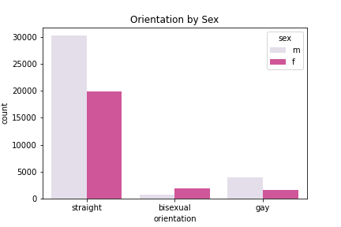
Sexual orientation

Slide 4
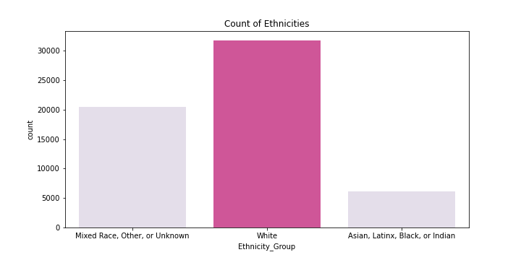
ethnicity

Slide 5
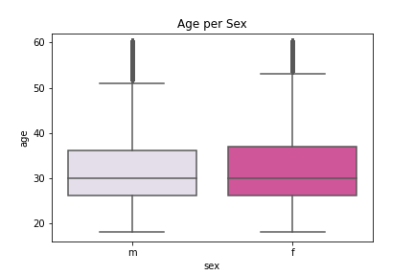
age

Slide 6
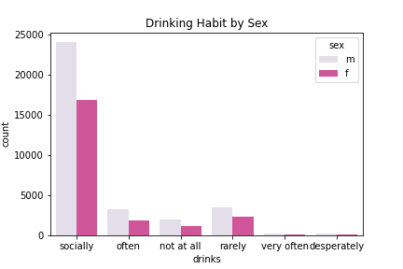
Drinking Habits

Slide 7
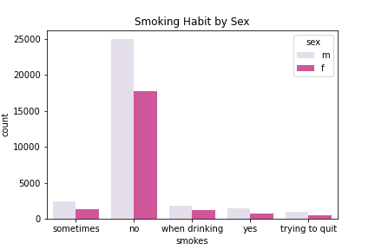
smoking Habits

Slide 8
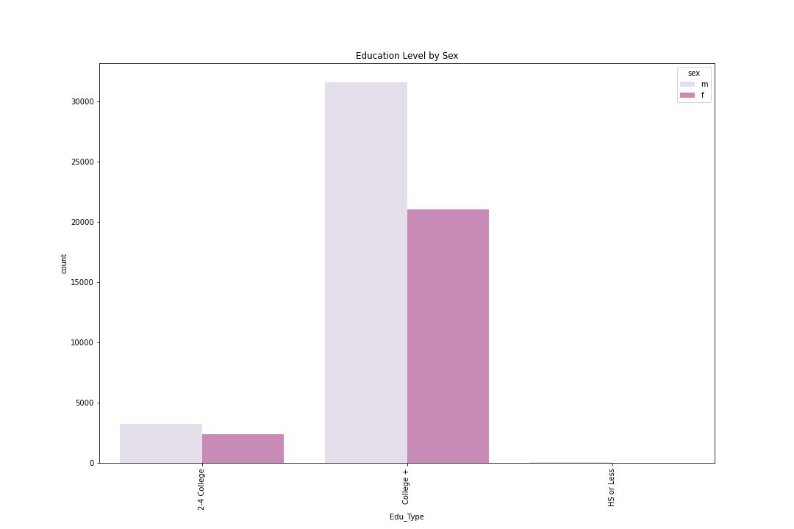
Education level

Slide 9
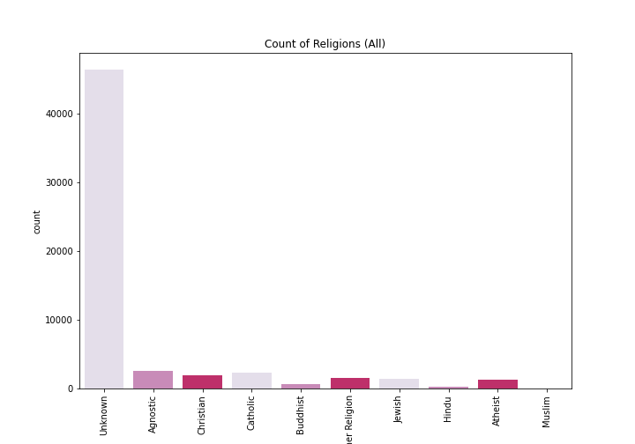
We don’t talk about religion…

Slide 10
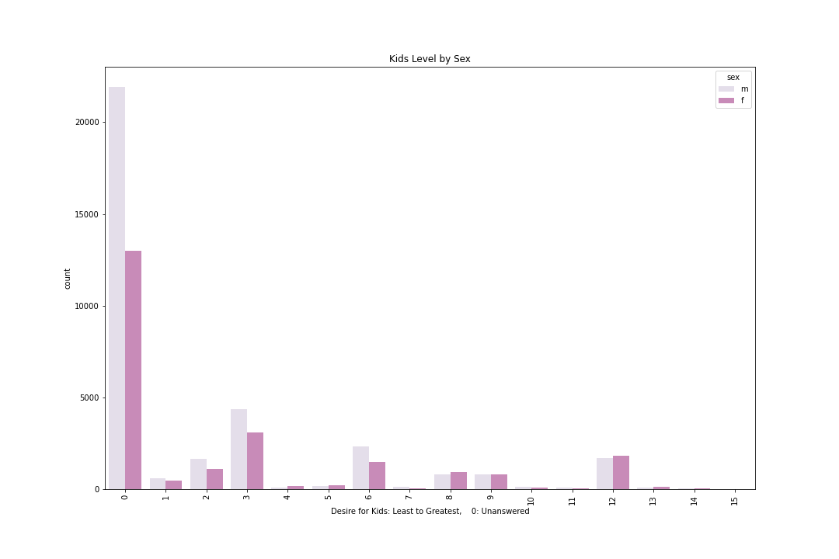
… Or kids…

Slide 11
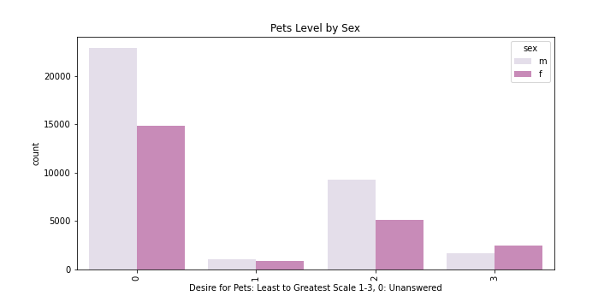
… Or pets…

Slide 12
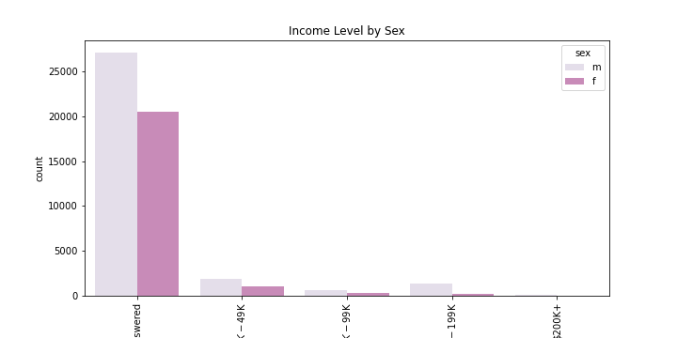
… Or money

Slide 13
Types of people on okcupid

Slide 14
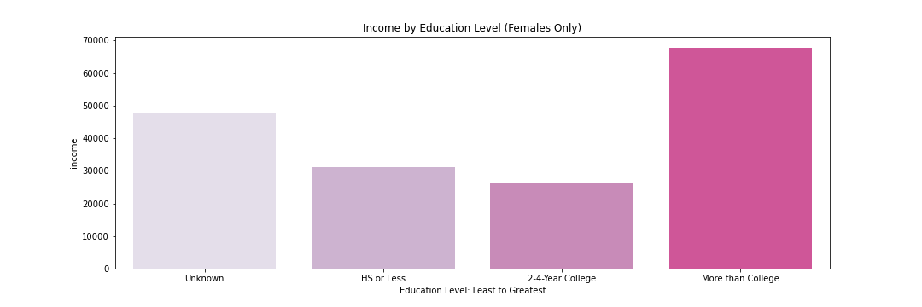
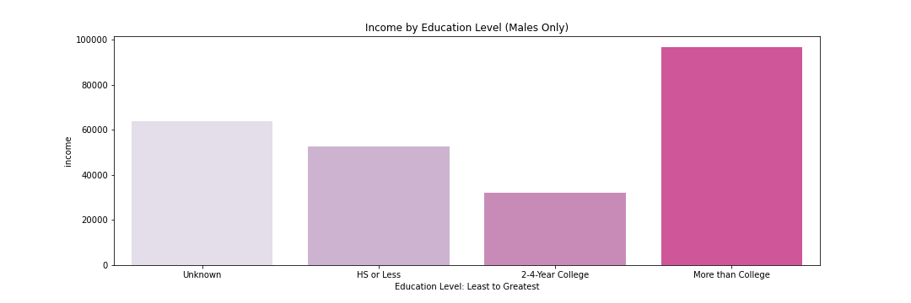
Highly educated people who earn more than others
$$$

Slide 15
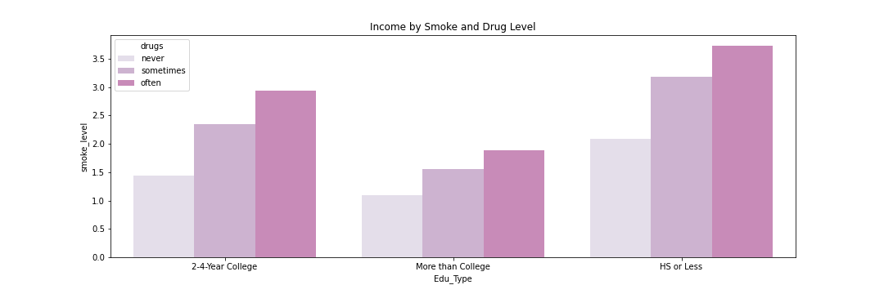
Highly educated people who do drugs less and smoke less

Slide 16
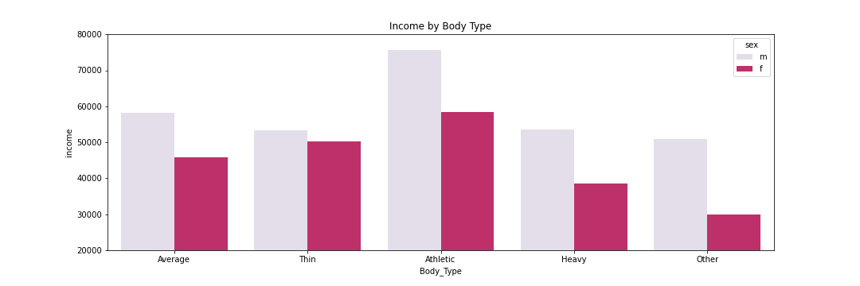
Athletic types who earn more than others

Slide 17
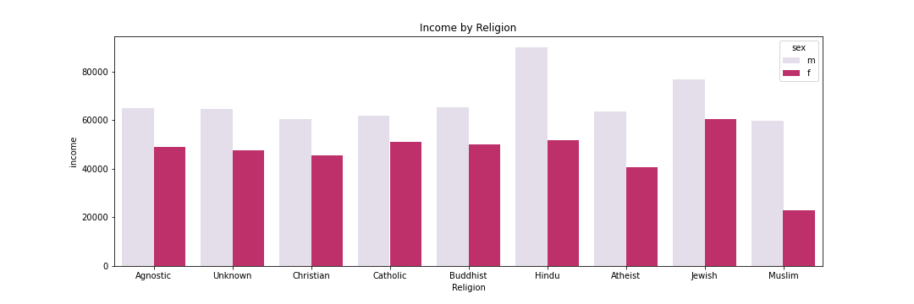
High-earning Hindu men and Jewish men and women
$
$
$

Slide 18
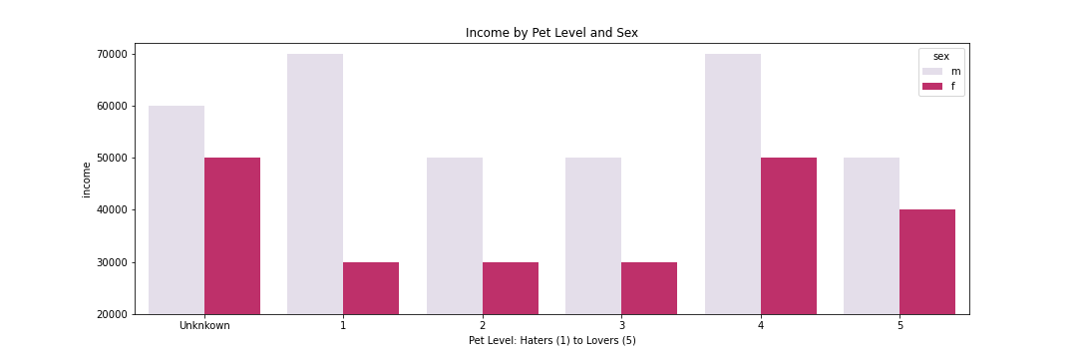
High-earning pet lovers and haters

Slide 19
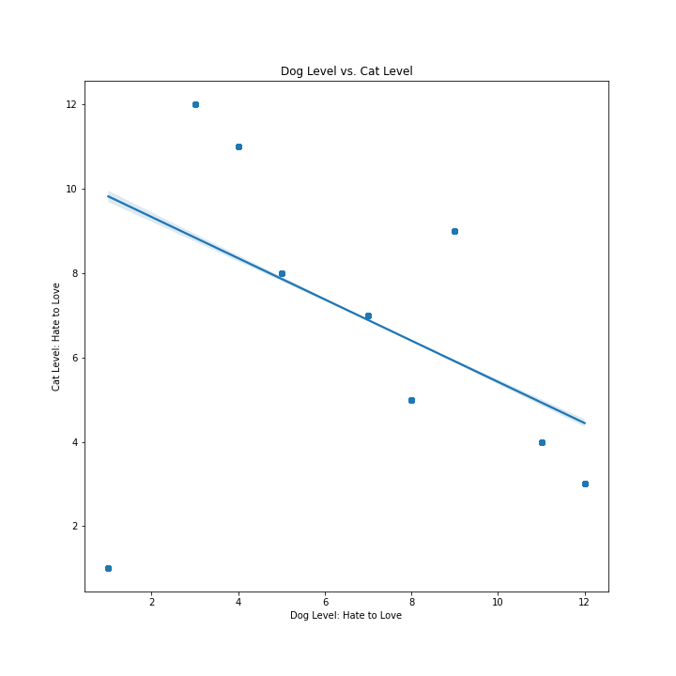
People who love dogs and hate cats (or vice versa)

Slide 20
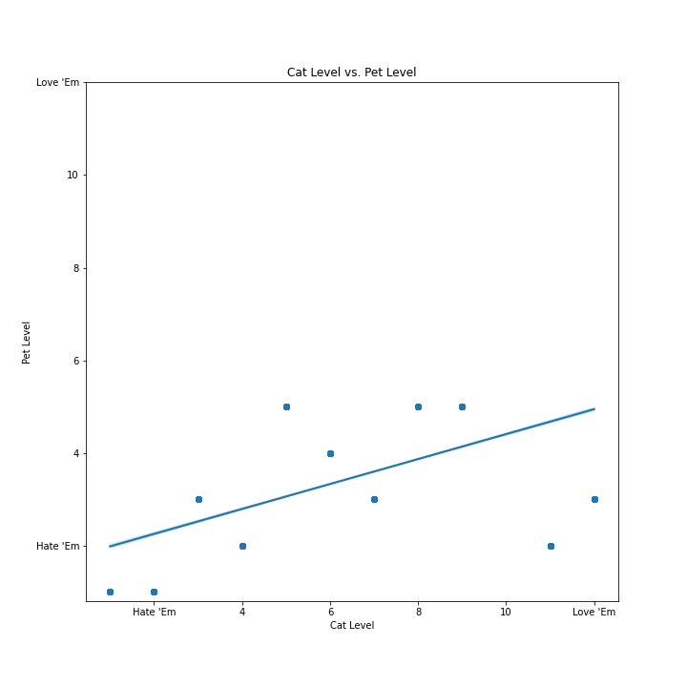
People who love cats and love pets in general (or vice versa)

Slide 21
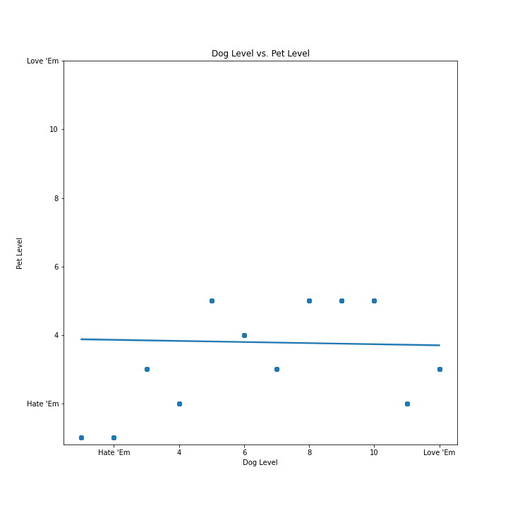
(in case you were wondering about dog people on okcupid…)

Slide 22
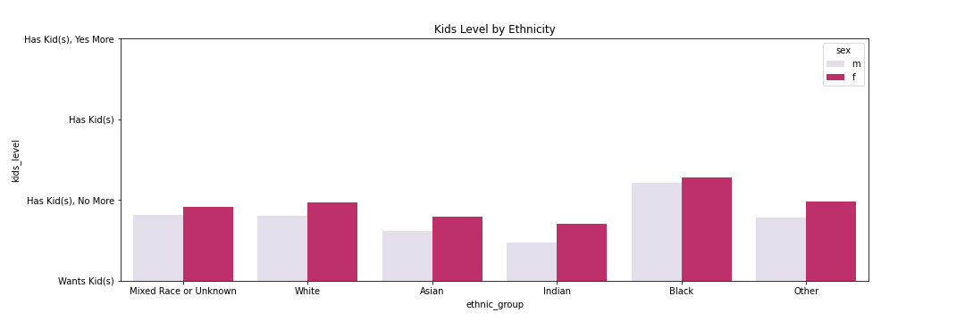
Asian people who aren’t enthusiastic about kids

Slide 23
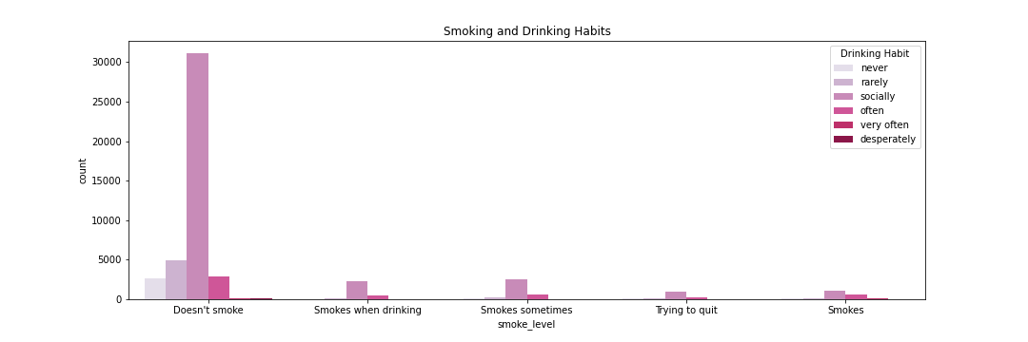
People who don’t smoke but drink socially

Slide 24
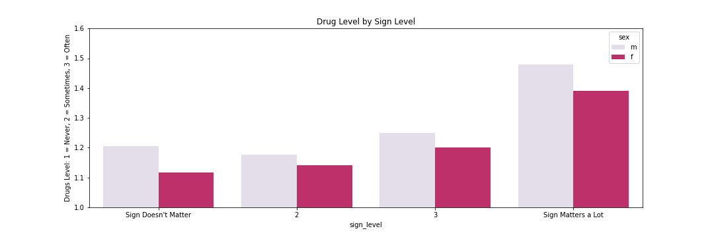
People who do more drugs and care about zodiac signs

Slide 25
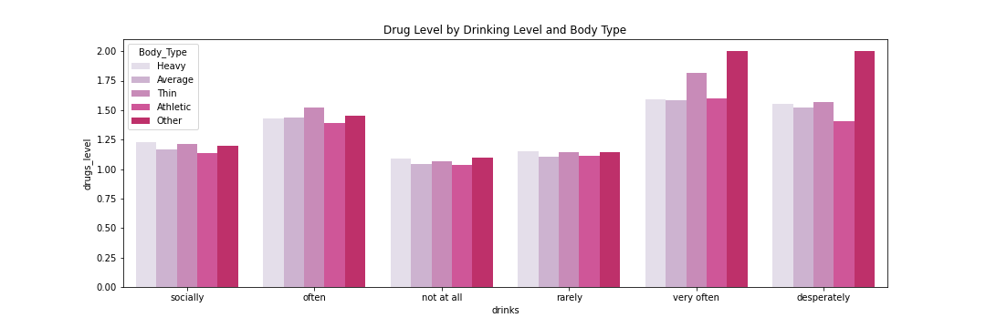
Fyi: People who won’t share body type drink and do drugs more

